Slide 1
TakeMeToHospital

Slide 2
PROBLEM STATEMENT
IN THE CASE OF EMERGENCY, PROVIDE THE ROUTES TO THE NEAREST HOSPITALS ALONG WITH THEIR WAIT TIME.

Slide 3
FEATURES
DISPLAY ALL THE HOSPITALS WITHIN THE RADIUS OF 2 MILES OF USER CURRENT LOCATION.
SHOWING DISTANCE AND ESTIMATED TIME TO TRAVEL FROM THE USER’S CURRENT LOCATION ON ANNOTATION TO THE SELECTED HOSPITAL.
SELECTING THE HOSPITAL AND PROVIDING DIFFERENT ROUTES TO USER TO REACH THE DESTINATION.
DISPLAY THE ROUTE TAKEN BY THE USER IN PAST FROM SAME LOCATION TO DESTINATION.
DISPLAY PAST TIME TRAVEL AND WAITING TIME OF THE HOSPITAL.

Slide 4
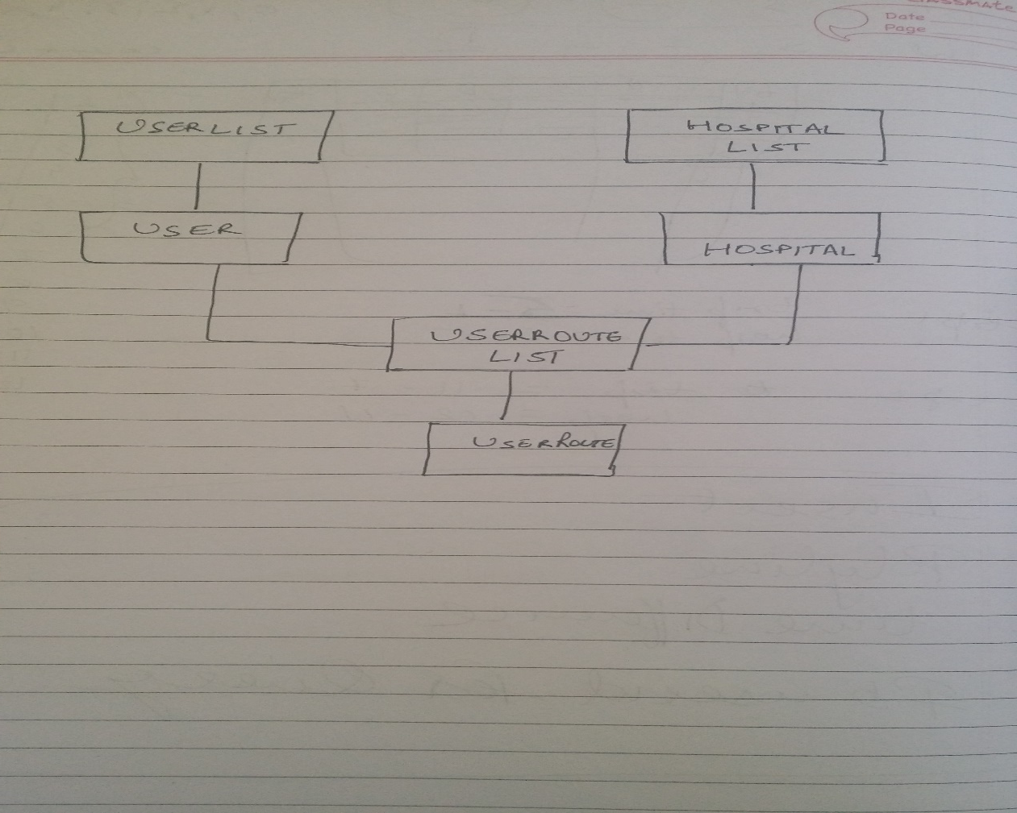
OBJECT MODEL

Slide 5
FRAMEWORKS USED
FACTUAL.
FACEBOOK API.
MAPKIT.

Slide 6
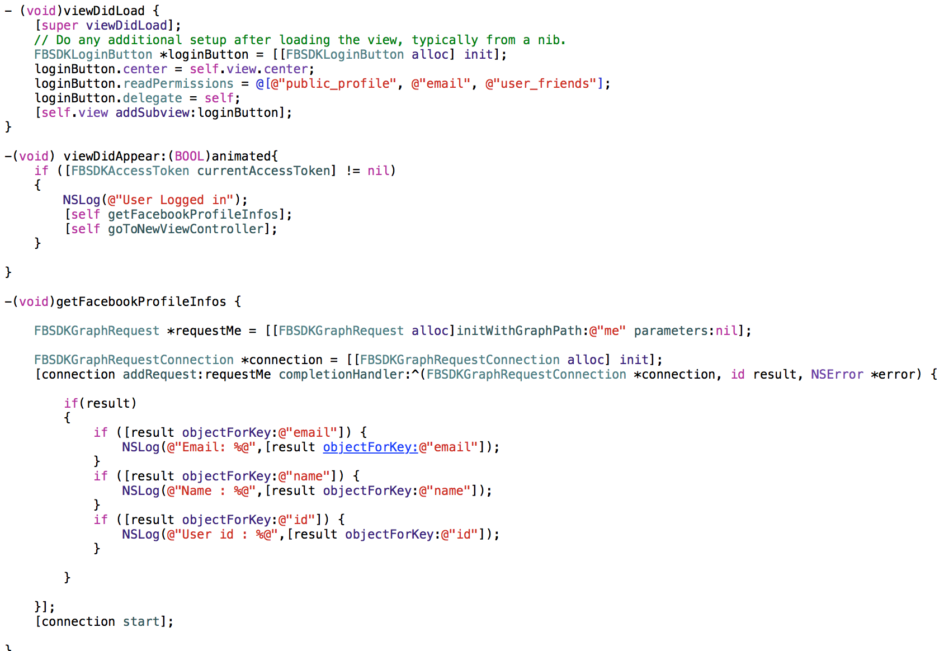
FACEBOOK API CODE

Slide 7
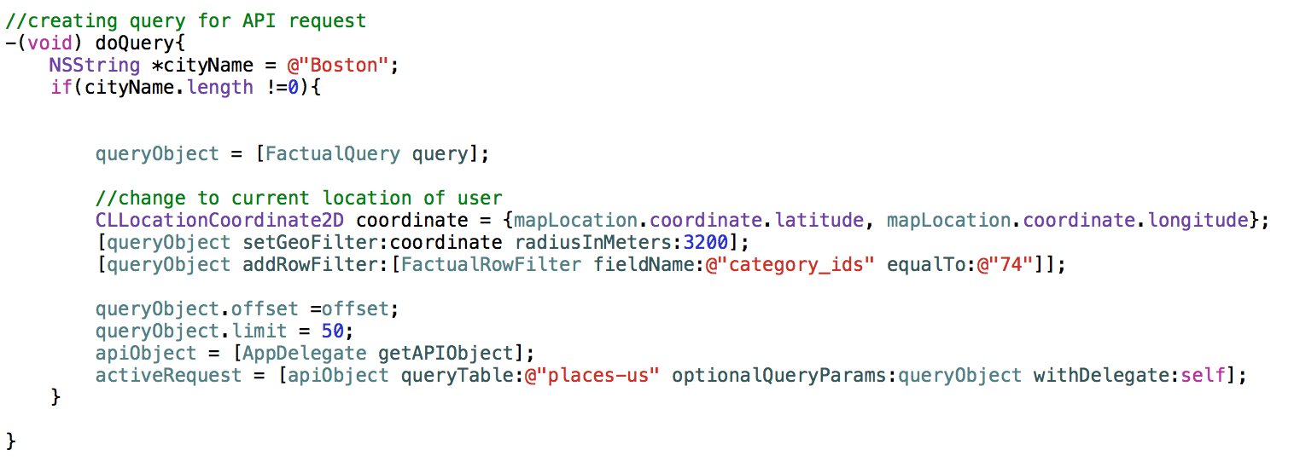
FACTUAL CODE

Slide 8
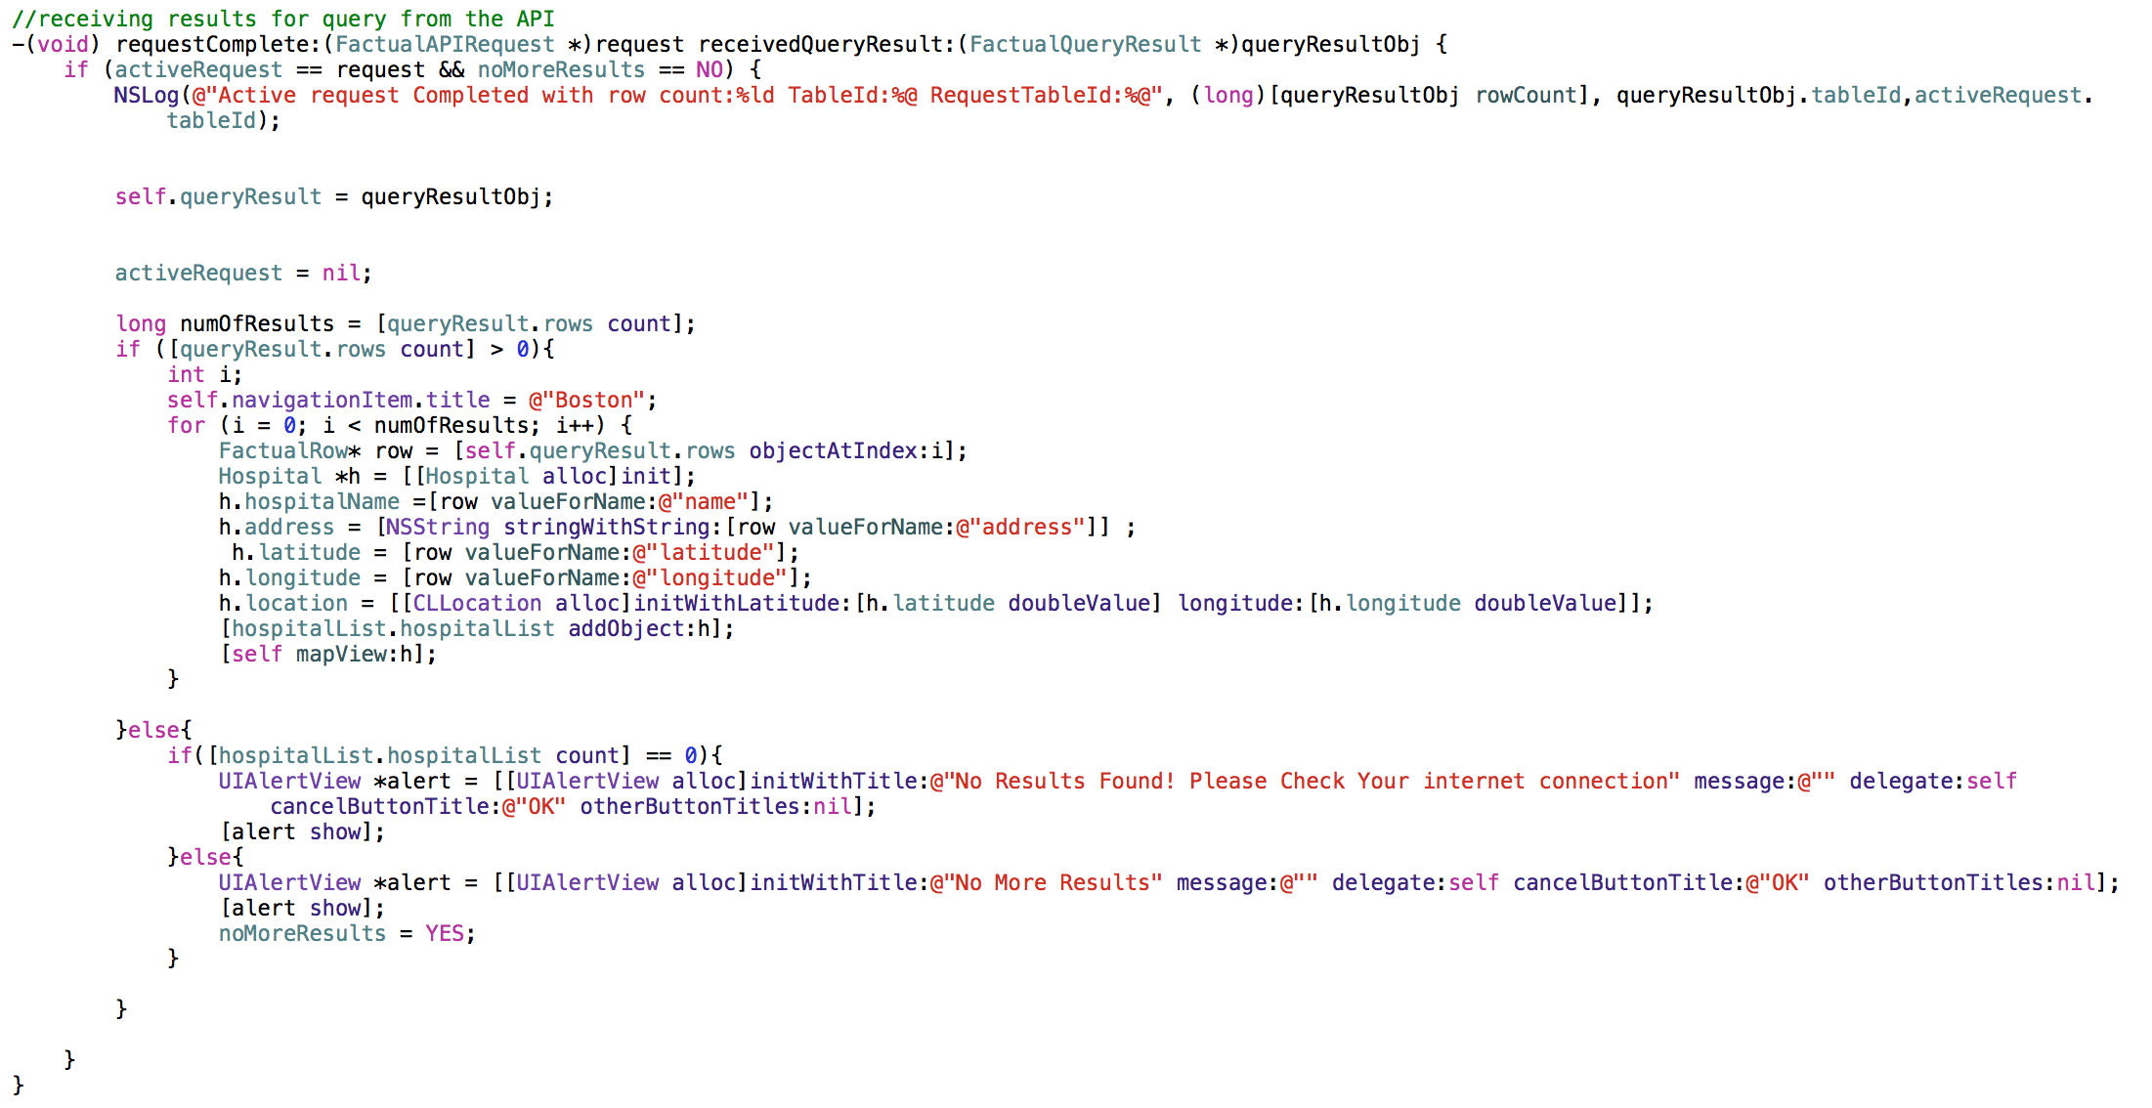
Result from factual api

Slide 9
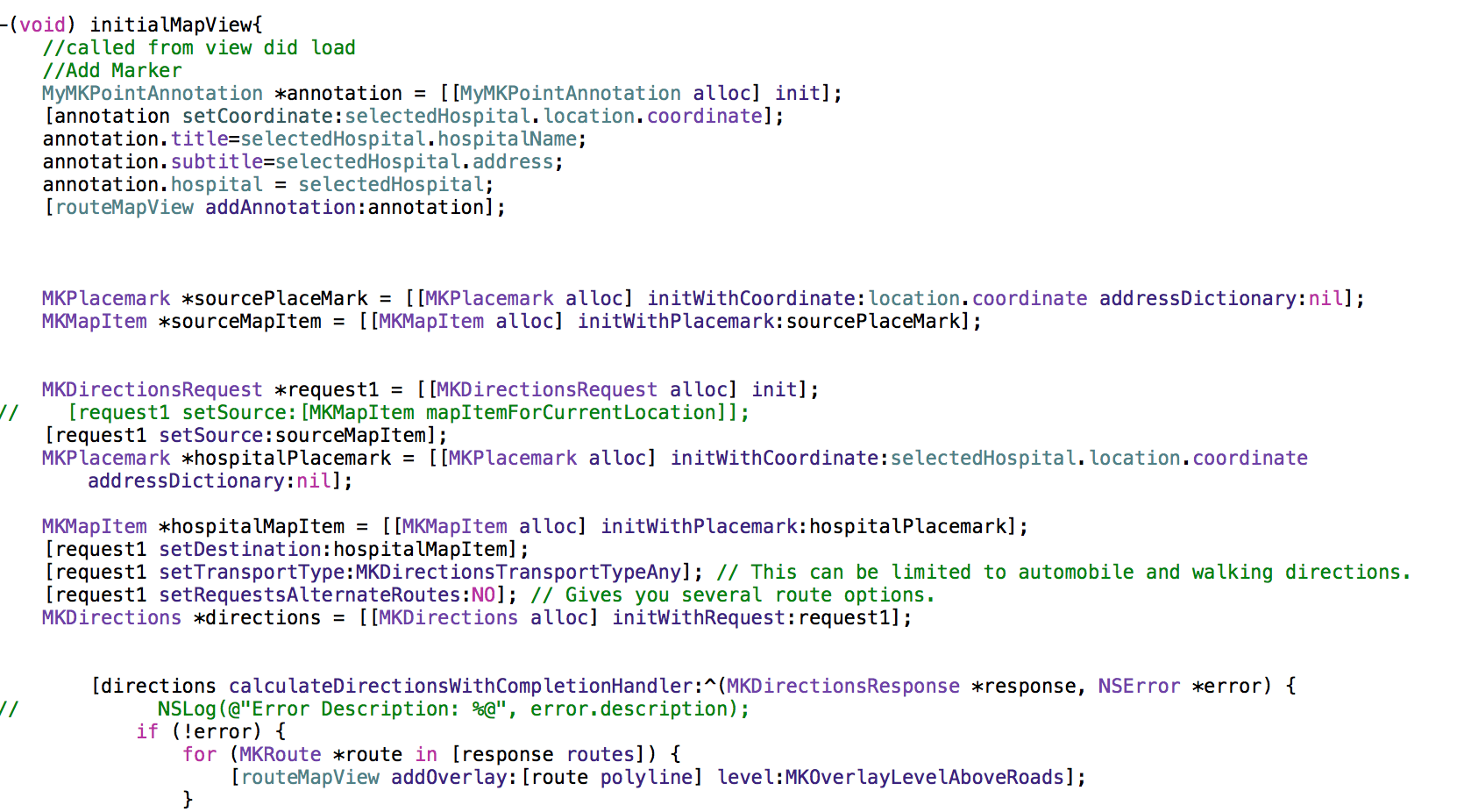
RENDERING CODE

Slide 10
SERVER COMPONENT
INSERT THE USER ROUTE INTO THE DATABASE.
EXTRACTING THE USER ROUTE HISTORY FROM THE DATABASE AND SUGGESTING ROUTES AND TIME TAKEN IN THE PAST.
INSERT THE COORDINATES AFTER REGULAR INTERVALS.

Slide 11
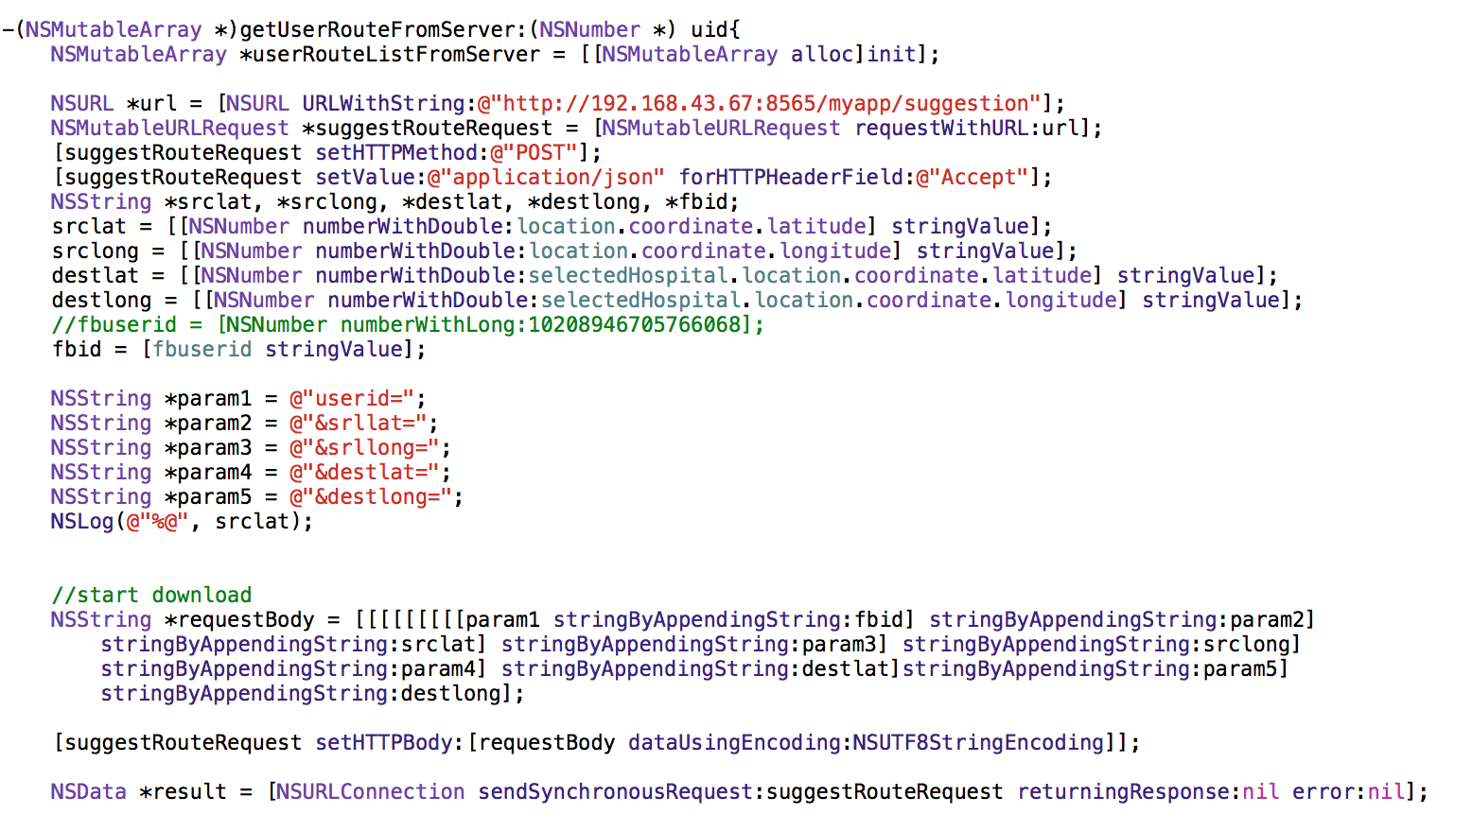
REQUEST TO SERVER TO GET PAST ROUTES

Slide 12
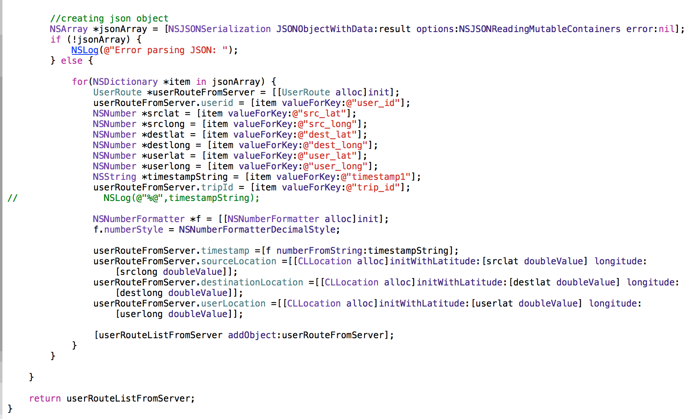
RESPONSE FROM SERVER

Slide 13
THANK YOU

